Slide 1
Spatial navigation with ring attractor networks
Sebastian Hannula

Slide 2
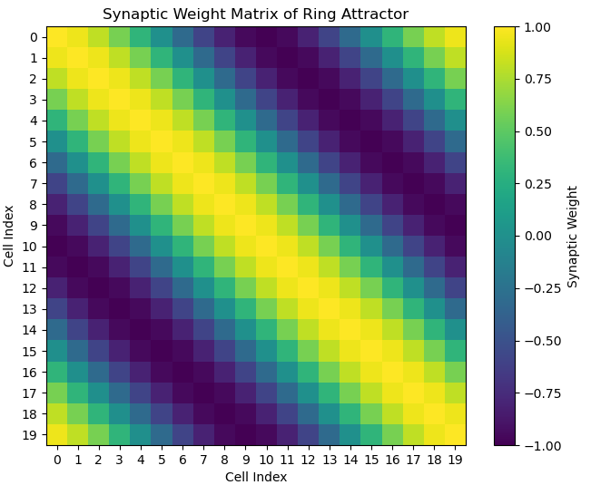
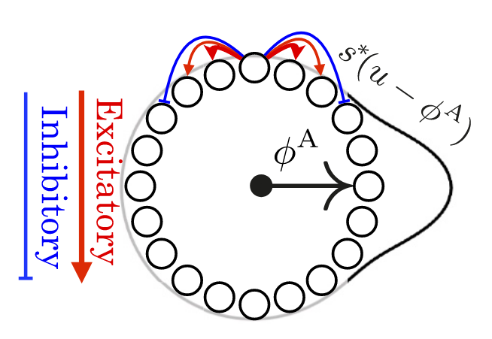
Ring Attractor Network
Excitatory connections to neighbors
Inhibitory connections to further away cells
Weight matrix visualized on right:

Slide 3
Ring Attractor Network
Interplay of close-by excitatory and further away inhibitory connections lead to stable dynamics seen in the gif to the right
The animation starts with a random initialization and converges to stable attractor point (animation is looped)
Red color indicates more activity

Slide 4
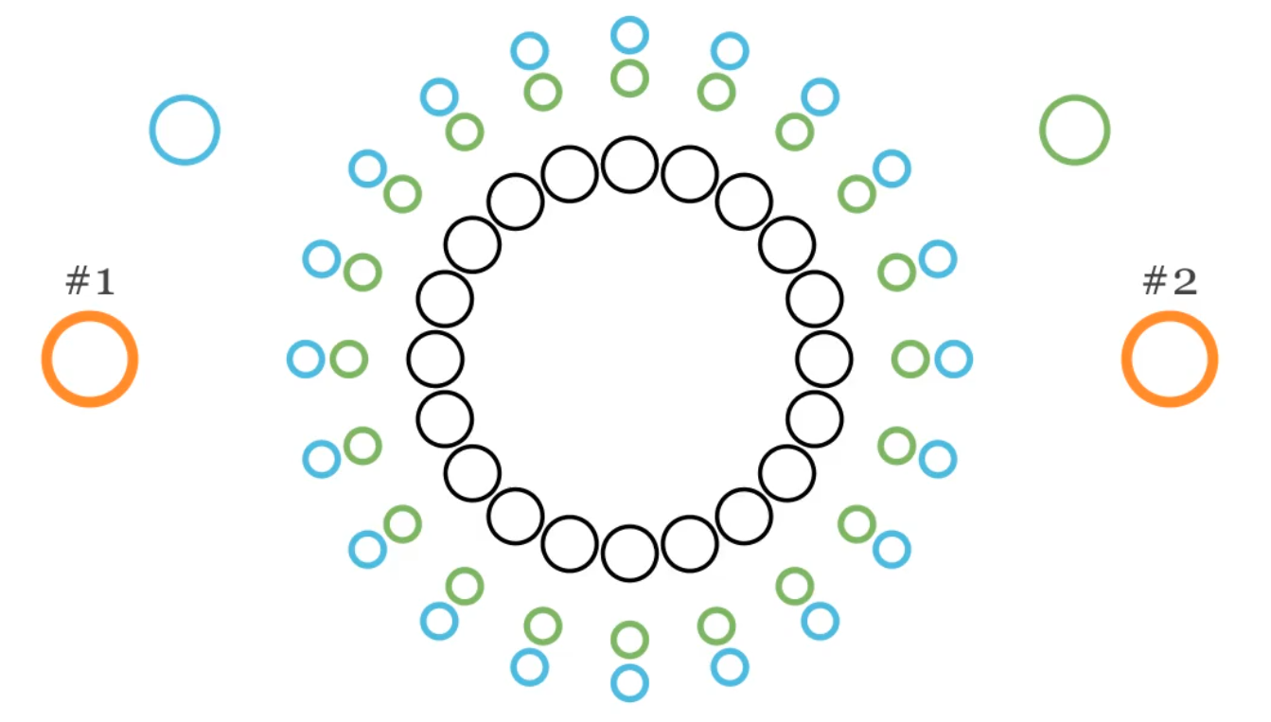
Full spatial navigation model (Ocko et al.)
Cell types:
Attractor cells (black)
Velocity sensitive cells (East & West) (green & blue)
Landmark cells (orange)
Capable of creating and maintaining consistent spatial map

Slide 5
Velocity cells and their connectivity
- Attractor network cell
- West sensitive velocity cell
- East sensitive velocity cell

Slide 6
Path integration with velocity sensitive cells
- Attractor network cell
- West sensitive velocity cell
- East sensitive velocity cell
- Spherical approximation of a mouse
Bump position not anchored to physical space yet!

Slide 7
Landmark cells and their connectivity
- Attractor network cell
- Landmark cell
- Physical landmark
- Spherical approximation of a mouse

Slide 8
Anchoring representation to landmark cells with Hebbian Learning
Hebbian learning in action
Weight decay for all synapses
Strengthening synapses of attractor cells firing at same time with Landmark cell
Slower time-scale
Synaptic strengths are driven towards long-time average of simultaneous activity

Slide 9
Learning a simple 1D environment
Integrating to the attractor ring, velocity cells and landmark cells with Hebbian plasticity allows an exploring animal to learn the geometry of its environment.
Here we see a mouse moving in a 1D world along with the activations and learning of the network.

Slide 10
References
Ocko SA, Hardcastle K, Giocomo LM, Ganguli S. Emergent elasticity in the neural code for space. Proc Natl Acad Sci U S A. 2018 Dec 11;115(50):E11798-E11806. doi: 10.1073/pnas.1805959115.
Animation source code: https://github.com/sebastianhannula/Spatial_navigation_attractor_network

